Slide 1
Chapter 7
How to work with file I/O

Slide 2
Objectives
Applied
Use text, CSV, or binary files to save and retrieve the data that’s used by your programs.
Knowledge
Differentiate between text and binary files.
Describe the benefit of using a with statement for opening and closing a file.
Describe the use of the csv module, writer objects, and reader objects for writing a list of lists to a CSV file and reading a list of lists from a CSV file.
Describe the use of the pickle module and the load() and dump() methods for saving a list of lists to a binary file and reading a list of lists from a binary file.

Slide 3
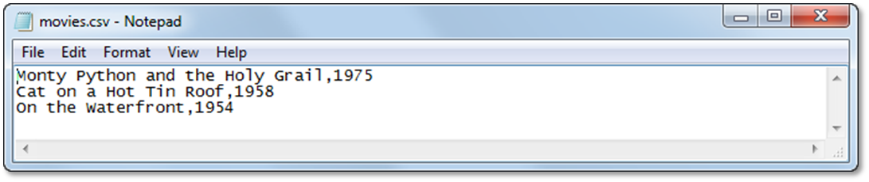
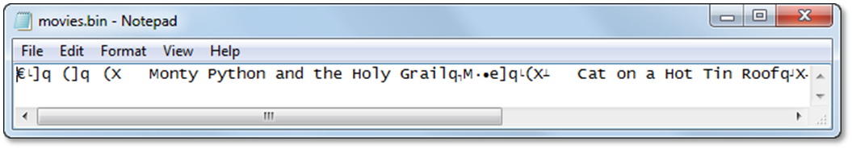
Two types of files
Text
Binary
A text file that’s opened by a text editor
A binary file with the same data

Slide 4
The sequence of file operations
Open the file.
Write data to the file or read data from the file.
Close the file.

Slide 5
The built-in open() function
open(file, mode)
A few of its modes
Character Mode
r Read
w Write
a Append
b Binary
The close() method of a file object
close()

Slide 6
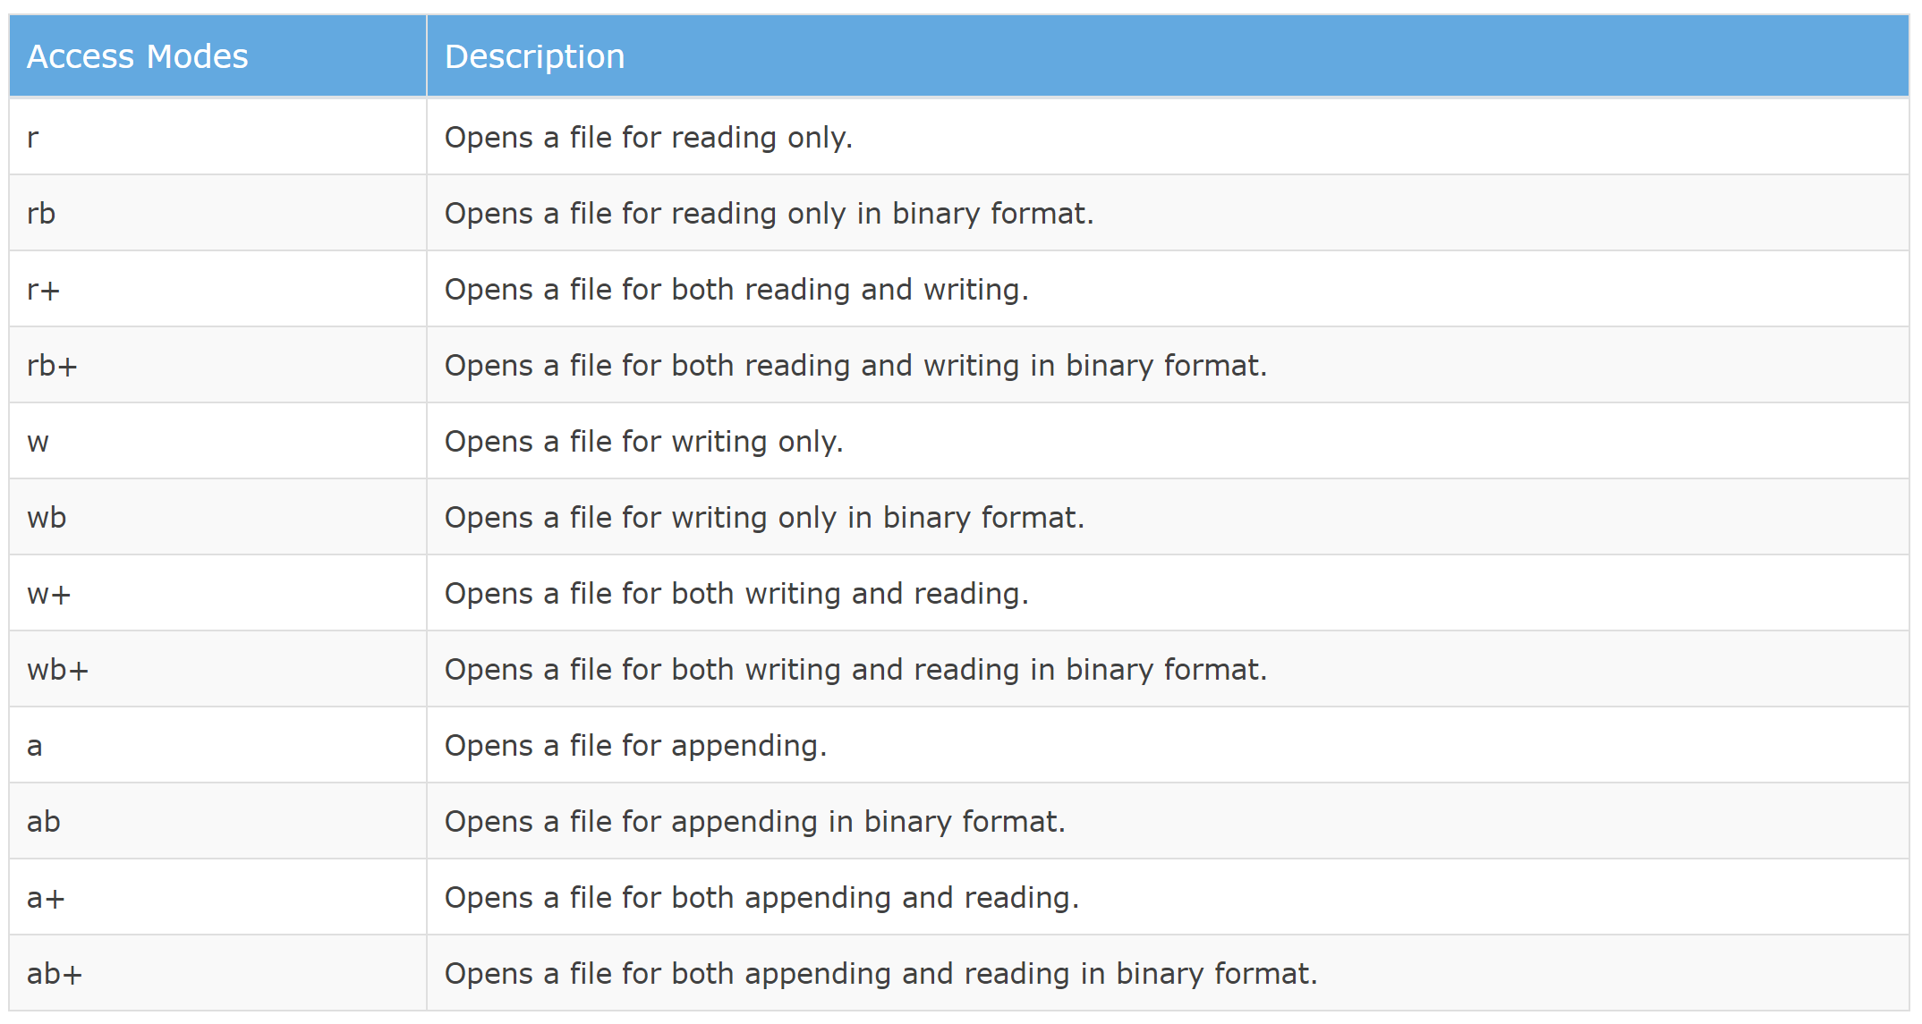
The built-in open() function
Notes:
https://www.tutorialsteacher.com/python/python-read-write-file

Slide 7
The built-in open() function
To open the file, use the built-in open() function.
The open() function returns a file object, which has a read() method for reading the content of the file:
Return the 5 first characters of the file:
f = open("demofile.txt", "r") print(f.read())
f = open("demofile.txt", "r") print(f.read(5))
Notes:
https://www.tutorialsteacher.com/python/python-read-write-file

Slide 8
How to open a file in write mode and close the file manually
outfile = open("test.txt", "w")
outfile.write("Test")
outfile.close()

Slide 9
How to use with statements to open and close files
The syntax of the with statement for file I/O
with open(file, mode) as file_object:
statements...
Code that opens a text file in write mode and automatically closes it
with open("test.txt", "w") as outfile:
outfile.write("Test")
Code that opens a text file in read mode and automatically closes it
with open("test.txt", "r") as infile:
print(infile.readline())

Slide 10
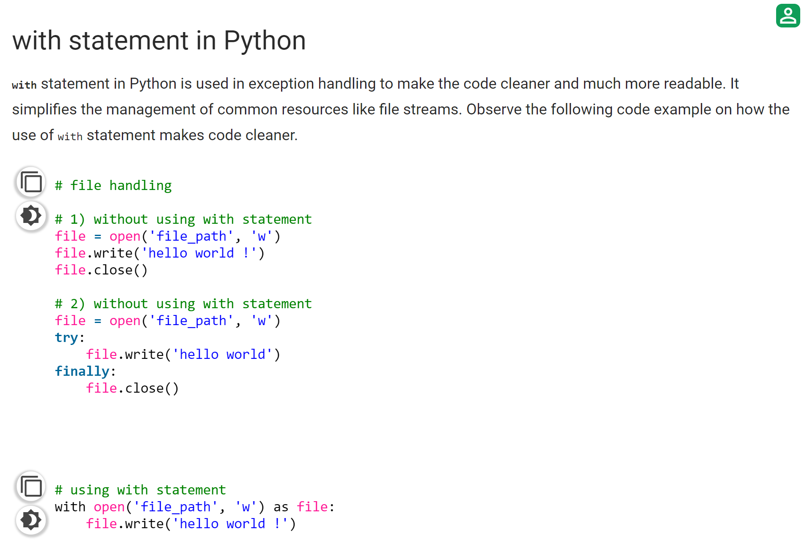
How to use with statements to open and close files
Notes:
https://www.geeksforgeeks.org/with-statement-in-python/

Slide 11
The write() method of a file object
write(str)
How to write one line to a text file
with open("members.txt", "w") as file:
file.write("John Cleese\n")
How to append one line to a text file
with open("members.txt", "a") as file:
file.write("Eric Idle\n")

Slide 12
The contents of the text file after the two lines have been written
John Cleese\nEric Idle\n
The contents of the text file when viewed in a text editor
John Cleese
Eric Idle

Slide 13
Three read methods of a file object
read()
readlines()
readline()

Slide 14
How to use a loop to read each line of the file
with open("members.txt") as file:
for line in file:
print(line, end="")
print()
How to read the entire file as a string
with open("members.txt") as file:
contents = file.read()
print(contents)
The result that’s printed to the console
John Cleese
Eric Idle

Slide 15
How to read the entire file as a list
with open("members.txt") as file:
members = file.readlines();
print(members[0], end="")
print(members[1])
How to read each line of the file
with open("members.txt") as file:
member1 = file.readline();
print(member1, end="")
member2 = file.readline();
print(member2)
The result that’s printed to the console
John Cleese
Eric Idle

Slide 16
How to write and read a list of strings
How to write the items in a list to a file
members = ["John Cleese", "Eric Idle"]
with open("members.txt", "w") as file:
for m in members:
file.write(m + "\n") # adds new line
How to read the lines in a file into a list
members = []
with open("members.txt") as file:
for line in file:
line = line.replace("\n", "") # removes new line
members.append(line)
print(members)
The result that’s printed to the console
['John Cleese', 'Eric Idle']

Slide 17
How to write and read a list of numbers
How to write the items in a list to a file
years = [1975, 1979, 1983]
with open("years.txt", "w") as years_file:
for year in years:
years_file.write(str(year) + "\n")
# converts int to str
How to read the items in a list from a file
years = []
with open("years.txt") as file:
for line in file:
line = line.replace("\n", "")
years.append(int(line)) # converts str to int
print(years)
The result that’s printed to the console
[1975, 1979, 1983]

Slide 18
The user interface for the Movie List 1.0 program
The Movie List program
COMMAND MENU
list - List all movies
add - Add a movie
del - Delete a movie
exit - Exit program
Command: list
1. Monty Python and the Holy Grail
2. Cat on a Hot Tin Roof
3. On the Waterfront
Command: add
Movie: Casablanca
Casablanca was added.
Command: list
1. Monty Python and the Holy Grail
2. Cat on a Hot Tin Roof
3. On the Waterfront
4. Casablanca
Command: del
Number: 4
Casablanca was deleted.

Slide 19
The code for the Movie List 1.0 program (part 1)
FILENAME = "movies.txt"
def write_movies(movies):
with open(FILENAME, "w") as file:
for movie in movies:
file.write(movie + "\n")
def read_movies():
movies = []
with open(FILENAME) as file:
for line in file:
line = line.replace("\n", "")
movies.append(line)
return movies
def list_movies(movies):
for i in range(len(movies)):
movie = movies[i]
print(str(i+1) + ". " + movie)
print()

Slide 20
The code for the Movie List 1.0 program (part 2)
def add_movie(movies):
movie = input("Movie: ")
movies.append(movie)
write_movies(movies)
print(movie + " was added.\n")
def delete_movie(movies):
index = int(input("Number: "))
movie = movies.pop(index - 1)
write_movies(movies)
print(movie + " was deleted.\n")
def display_menu():
print("The Movie List program")
print()
print("COMMAND MENU")
print("list - List all movies")
print("add - Add a movie")
print("del - Delete a movie")
print("exit - Exit program")
print()

Slide 21
The code for the Movie List 1.0 program (part 3)
def main():
display_menu()
movies = read_movies()
while True:
command = input("Command: ")
if command == "list":
list_movies(movies)
elif command == "add":
add_movie(movies)
elif command == "del":
delete_movie(movies)
elif command == "exit":
print("Bye!")
break
else:
print("Not a valid command. Please try again.")
if __name__ == "__main__":
main()

Slide 22
The writer() function of the CSV module
writer(file)
The writerows() method of the CSV writer object
writerows(rows)

Slide 23
A 2-dimensional list with 3 rows and 2 columns
movies = [["Monty Python and the Holy Grail", 1975],
["Cat on a Hot Tin Roof", 1958],
["On the Waterfront", 1954]]
How to import the csv module
import csv
How to write the list to a CSV file
with open("movies.csv", "w", newline="") as file:
writer = csv.writer(file)
writer.writerows(movies)
The contents of the CSV file
Monty Python and the Holy Grail,1975
Cat on a Hot Tin Roof,1958
On the Waterfront,1954

Slide 24
The reader() function of the csv module
reader(file)
How to read data from a CSV file
with open("movies.csv", newline="") as file:
reader = csv.reader(file)
for row in reader:
print(row[0] + " (" + str(row[1]) + ")")
The console
Monty Python and the Holy Grail (1975)
Cat on a Hot Tin Roof (1958)
On the Waterfront (1954)

Slide 25
Some optional arguments that can be used to change the CSV format
quoting=csv.QUOTE_MINIMAL
quotechar='"'
delimiter=","
Code that changes the delimiter for the writer object
writer = csv.writer(file, delimiter="\t")
Code that changes the delimiter for the reader object
reader = csv.reader(file, delimiter="\t")

Slide 26
The user interface for the Movie List 2.0 program
The Movie List program
COMMAND MENU
list - List all movies
add - Add a movie
del - Delete a movie
exit - Exit program
Command: list
1. Monty Python and the Holy Grail (1975)
2. Cat on a Hot Tin Roof (1958)
3. On the Waterfront (1954)
Command: add
Name: Gone with the Wind
Year: 1939
Gone with the Wind was added.
Command: list
1. Monty Python and the Holy Grail (1975)
2. Cat on a Hot Tin Roof (1958)
3. On the Waterfront (1954)
4. Gone with the Wind (1939)
Command: del
Number: 4
Gone with the Wind was deleted.

Slide 27
The code for the Movie List 2.0 program (part 1)
import csv
# a file in the current directory
FILENAME = "movies.csv"
def write_movies(movies):
with open(FILENAME, "w", newline="") as file:
writer = csv.writer(file)
writer.writerows(movies)
def read_movies():
movies = []
with open(FILENAME, newline="") as file:
reader = csv.reader(file)
for row in reader:
movies.append(row)
return movies
def list_movies(movies):
for i in range(len(movies)):
movie = movies[i]
print(str(i+1) + ". " + movie[0] + " (" + movie[1] + ")")
print()

Slide 28
The code for the Movie List 2.0 program (part 2)
def add_movie(movies):
name = input("Name: ")
year = input("Year: ")
movie = []
movie.append(name)
movie.append(year)
movies.append(movie)
write_movies(movies)
print(name + " was added.\n")
def delete_movie(movies):
index = int(input("Number: "))
movie = movies.pop(index - 1)
write_movies(movies)
print(movie[0] + " was deleted.\n")
def display_menu():
print("The Movie List program")
print()
print("COMMAND MENU")
print("list - List all movies")
print("add - Add a movie")
print("del - Delete a movie")
print("exit - Exit program\n")

Slide 29
The code for the Movie List 2.0 program (part 3)
def main():
display_menu()
movies = read_movies()
while True:
command = input("Command: ")
if command.lower() == "list":
list_movies(movies)
elif command.lower() == "add":
add_movie(movies)
elif command.lower() == "del":
delete_movie(movies)
elif command.lower() == "exit":
break
else:
print("Not a valid command. Please try again.\n")
print("Bye!")
if __name__ == "__main__":
main()

Slide 30
Two methods of the pickle module
dump(object, bfile)
load(bfile)

Slide 31
A 2-dimensional list of movies
movies = [["Monty Python and the Holy Grail", 1975],
["Cat on a Hot Tin Roof", 1958],
["On the Waterfront", 1954]]
How to import the pickle module
import pickle
How to write an object to a binary file
with open("movies.bin", "wb") as file: # write binary
pickle.dump(movies, file)

Slide 32
How to read an object from a binary file
with open("movies.bin", "rb") as file: # read binary
movie_list = pickle.load(file)
print(movie_list)
The console
[['Monty Python and the Holy Grail', 1975], ['Cat on a Hot Tin Roof', 1958], ['On the Waterfront', 1954]]

Slide 33
The user interface for the Movie List 3.0 program
The Movie List program
COMMAND MENU
list - List all movies
add - Add a movie
del - Delete a movie
exit - Exit program
Command: list
1. Monty Python and the Holy Grail (1975)
2. Cat on a Hot Tin Roof (1958)
3. On the Waterfront (1954)
Command: add
Name: Gone with the Wind
Year: 1939
Gone with the Wind was added.

Slide 34
The code for the two file I/O functions
import pickle
FILENAME = "movies.bin"
def write_movies(movies):
with open(FILENAME, "wb") as file:
pickle.dump(movies, file)
def read_movies():
movies = []
with open(FILENAME, "rb") as file:
movies = pickle.load(file)
return movies
The code for the list_movies() function
def list_movies(movies):
for i in range(len(movies)):
movie = movies[i]
print(str(i+1) + ". " + movie[0] + " ("
+ str(movie[1]) + ")")
print()

